Slide 1
Business Performance Analysis
Sales, Profit, and Cost Overview

Slide 2
Sum of Sales: 4.91 M
Sum of Cost: 63.69 M
Sum of Profit: 377.10
Insights: The Profit is very low compared to cost and sales

Slide 3
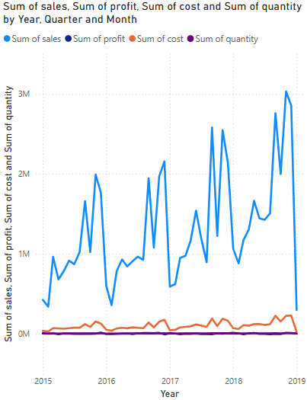
Insights:
The sales, profits, and cost has a repeating pattern each year:
Low during January, February
A small increase during March, April
A negligible increase or almost constant during May, June, July, August
A rapid increase and reaches peak during September
A rapid decrease and falls during October
Again increases and reaches peak during November
Starts to fall during December

Slide 4
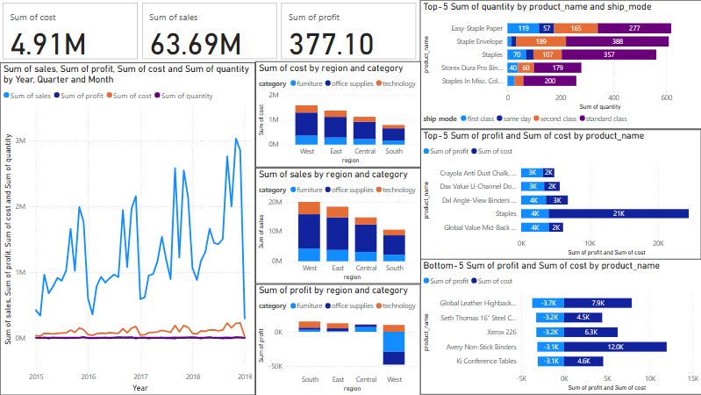
Insights:
Standard Class shipping dominates the shipping mode in most quantity sold products indicating customers prefer affordable shipping mode.
Staples is the most profitable product despite its high cost, showing strong demand.
Global Leather Highback Chair and Avery Non-Stick Binders are major loss causing products due to high costs and negative profit.

Slide 5
Insights:
West region leads in cost, sales but shows high profit compared to other regions.
In all the regions Office Supplies contributes to the majority of the profit.
South region is causing losses, showing negative profit despite having low cost, and sales.

Slide 6
Power BI Dashboard

